Slide 1
ANATOMY OF THE URETHRA
BY
DR A.O OJEWALE

Slide 2
Outline
Intro
Parts
The features of different parts
Urethral mucosa
Sphincters of the Urethra
Applied Anatomy

Slide 3
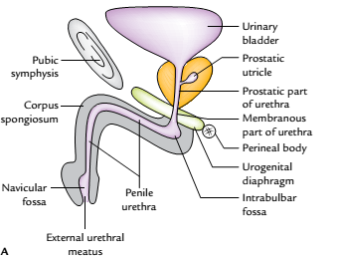
Intro’
The urethra is a tubular passage, which transmits urine and seminal fluid in males and only urine in females.
The male urethra is about 18-20 cm long.
It extends from the internal urethral orifice at the neck of the urinary bladder to the external urethral orifice (EUO) at the tip of the glans penis.
Left view in the sagittal section
of the male urethra

Slide 4
Cont’d
The long axis of the urethra presents two curvatures and is therefore S-shaped in flaccid state of the penis. The distal curvature disappears and as a result it becomes J-shaped in erect state of the penis.

Slide 5
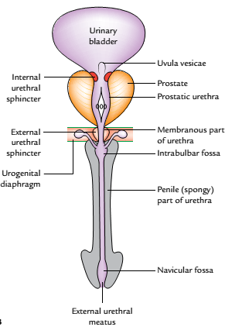
Parts of the male urethra
The urethra is divided into the following three parts according to its location:
Prostatic part (passes through the prostate).
Membranous part (passes through the urogenital diaphragm).
Spongy or penile part (passes through the corpus spongiosum of penis).
Anterior view of the male urethra

Slide 6
Cont’d
Prostatic part of the urethra (3 cm long) traverses through the anterior part of the prostate. It is the widest and most dilatable part of the male urethra. It is fusiform in the coronal section.
The inner aspect of its posterior wall of the prostatic urethra presents the following features:
Urethral crest, a median longitudinal ridge of the mucous membrane.
Colliculus seminalis (verumontanum), an elevation on the middle of the urethral crest.

Slide 7
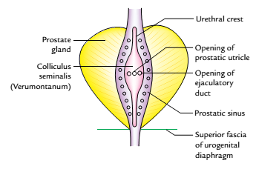
Cont’d
The prostatic utricle opens on its summit by a slit-like orifice. On either side of the orifice of the prostatic utricle opens the ejaculatory ducts.
Prostatic sinuses, vertical grooves one on each side of the urethral crest. Each sinus presents 15-20 openings of the prostatic glands.
Features of the posterior wall of the prostatic urethra

Slide 8
Cont’d
Membranous part of the Urethra (2 cm long) traverses through the urogenital diaphragm and pierces the perineal membrane about 2.5 cm below and behind the pubic symphysis. It is surrounded by the sphincter urethrae muscle, which serves as the voluntary external sphincter of the bladder. With the exception of external urethral orifice, it is the narrowest and least dilatable part of the urethra. Numerous mucous glands are often found in it. In cross section, its lumen is star-shaped.

Slide 9
Cont’d
Spongy part of the Urethra (15 cm long) traverses through the corpus spongiosum of the penis. It first passes upward and forward in the bulb of penis to lie below the pubic symphysis. Then it bends downward and forward, and traverses the corpus spongiosum in the free part of the penis and terminates as the external urethral orifice just below the tip of glans penis. It presents two dilatations: in the bulb of penis to form intrabulbar fossa (3 cm long) and in the glans penis to form navicular fossa/terminal fossa (1.25 cm long)

Slide 10
Cont’d
The shape of the spongy urethra differs in different parts, viz., trapezoid-shaped in the bulb, like a transverse slit in the body and like a vertical slit at the external urethral orifice in cross section.
The small simple tubular mucous glands called urethral glands (Littre’s glands) open in the entire spongy part of the urethra except in the terminal fossa.

Slide 11
Cont’d
The pit-like small mucous recesses, the urethral lacunae (of Morgagni) project from the entire spongy part of the urethra except in the terminal fossa. The lacunae receive the openings of urethral glands. One lacuna present in the roof of terminal fossa is called lacuna magna or sinus of Guerin.
The external urethral orifice is the narrowest part of the male urethra. It is in the form of a sagittal slit about 6 mm long.

Slide 12
The features of different parts of the male urethra
Features | Prostatic part | Membranous part | Spongy part
Location | Within prostate | Within urogenital diaphragm | Within penis (corpus spongiosum)
Length | 3 cm | 1.5-2 cm | 15 cm
Shape in cross section | Horseshoe shaped | Star-shaped | In the bulb-trapezoid In the body-transverse slit At external urethral orifice-vertical slit
Diameter and dilatability | Widest and most dilatable | Narrowest and least dilatable | Mostly uniform diameter with medium dilatation
Openings | Prostatic utricle Ejaculatory ducts Prostatic glands | Minute mucous glands | Urethral glands (Littre’s glands)

Slide 13
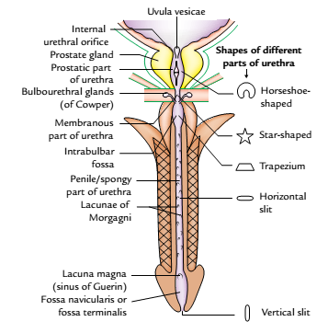
Different parts of the male urethra and their shapes

Slide 14
Urethral mucosa
The urethral mucosa presents regional variations as follows:
Prostatic urethra above the seminal colliculus is lined by transitional epithelium and below it by stratified columnar epithelium.
Membranous urethra is lined by stratified columnar epithelium.
Spongy urethra up to navicular fossa is lined by stratified columnar epithelium. The navicular fossa and external urethral orifice are lined by stratified squamous epithelium.

Slide 15
Sphincters of the urethra
The urethra has two sphincters-internal and external.
Internal Sphincter
The internal sphincter surrounds the internal urethral orifice and is probably formed from the muscle of the bladder wall. It is involuntary in nature and often termed sphincter vesicae. It is supplied by the sympathetic fibres from lower thoracic and upper lumbar segments of the spinal cord (T11 to L2). It relaxes during urination but closes (i.e., contracts) during ejaculation (to prevent the retrograde entry of semen into the bladder).

Slide 16
Cont’d
External Sphincter (or Sphincter urethrae)
The external sphincter surrounds the membranous part of the urethra and is derived from the sphincter urethrae muscle. It is voluntary in nature and is supplied by the pudendal nerve (S2, S3, S4).

Slide 17
Differences between the internal and external sphincters of the urethra
Internal urethral sphincter | External urethral sphincter
Surrounds the internal urethral orifice | Surrounds the membranous part of urethra
Derived from the bladder musculature of trigonal region | Derived from the sphincter urethrae muscle
Innervated by the sympathetic fibres (T11–L2 segments) | Innervated by the somatic fibres (S2, S3, S4 segments)
Involuntary | Voluntary

Slide 18
Applied Anatomy
Rupture of the urethra: The rupture of the urethra leads to extravasation of urine. The commonest site of rupture is bulb of the penis, just below the urogenital diaphragm following a fall astride a sharp object. The urethra is crushed against the edge of the pubic bones. The urine extravasates into the superficial perineal pouch and passes forward over the scrotum, penis, and anterior part of the anterior abdominal wall deep to membranous layer of the superficial fascia (superficial extravasation).

Slide 19
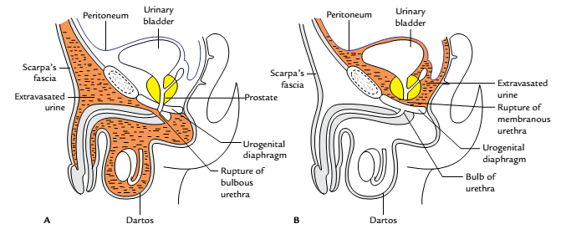
Cont’d
If the urethra ruptures above urogenital diaphragm, urine escapes above the deep perineal pouch and may pass upward around the prostate and bladder in the extraperitoneal space (deep extravasation).
Rupture of urethra: A, rupture of the bulbous urethra leading to superficial extravasation;
B,rupture of the urethra above the urogenital diaphragm leading to deep extravasation

Slide 20
Cont’d
Catheterization of the male urethra: It is done in the patients who are unable to pass urine and their bladders are distended due to retention of urine leading to severe discomfort and pain in the hypogastric region. While passing the catheter one should remember the normal curvatures of the urethra.
Above the external urethral meatus the urethra presents a large mucosal recess guarded by a mucosal fold, which may catch the tip of catheter.

Slide 21
Cont’d
The catheter should therefore always be introduced into the urethra with its beak turned downward. Otherwise the forceful insertion of catheter may create a false passage in urethra or rupture it.

Slide 22
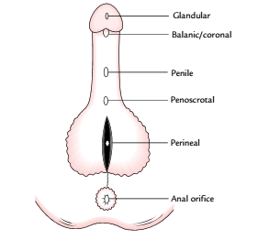
Cont’d
Hypospadias: It is a congenital anomaly in which external urethral orifice is located on the inferior/ventral aspect of penis instead at the tip of the glans penis. It occurs due to failure of the fusion of urethral folds. Depending upon the location of external urethral orifice (EUO). The hypospadias are classified into 5 types namely; glandular, balanic, penile, penioscrotal & perineal.
Types of Hypospadias

Slide 23
Cont’d
Glandular: If external urethral orifice opens on the under surface of the glans.
Balanic: If external urethral orifice opens at the base of glans penis.
Penile: If external urethral orifice opens on ventral aspect of the body of penis.
Penioscrotal: If external urethral orifice opens at the junction of penis and scrotum.
Perineal: If external urethral orifice opens as sagittal slit on ventral aspect of scrotum.

Slide 24


